Slide 1


Freshco Hypermarket Capstone
DHIVYALAKSHMI K B | DAP-202407-1 | 25/08/2024

Slide 2
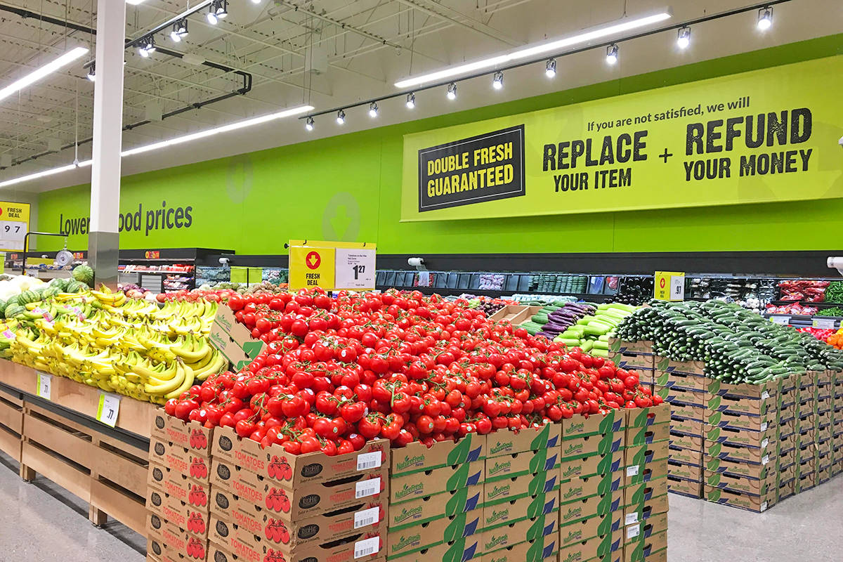
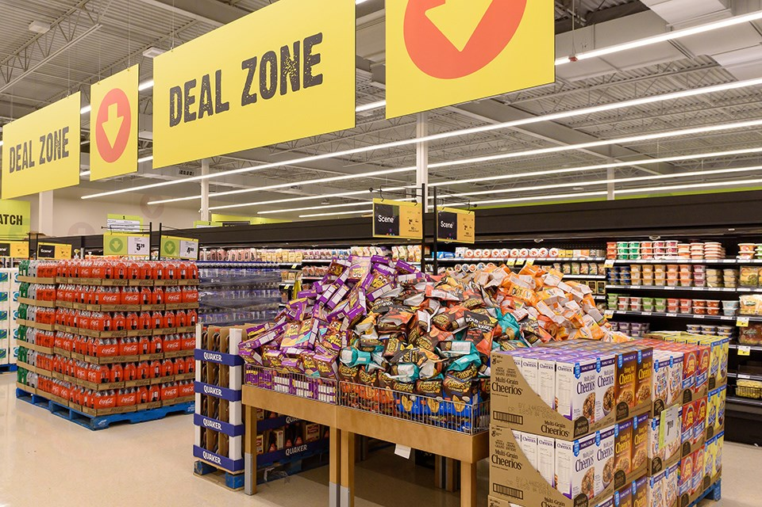



TABLE OF CONTENTS
Introduction
Order level Analysis
Customer Level Analysis
Delivery Analysis
Completion Rate Analysis

Slide 3

ORDER LEVEL ANALYSIS

Slide 4

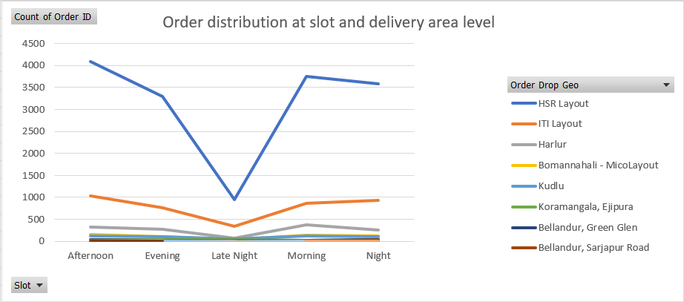
1. Identifying order distribution at slot and delivery area level.

Slide 5
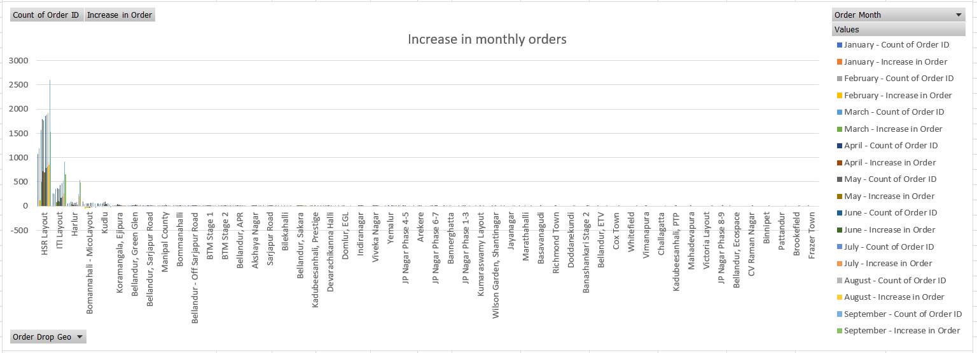
2. Identifying the areas having highest increase in monthly orders (from Jan to Sep) in absolute orders.

Slide 6
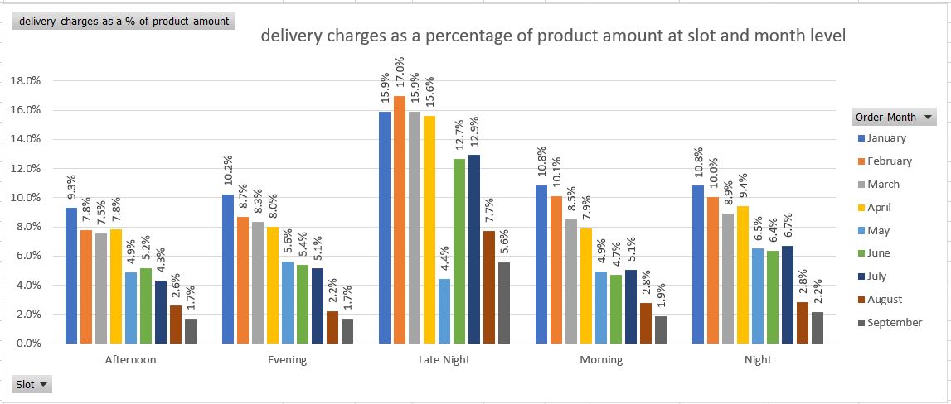
3. Calculate delivery charges as a percentage of product amount at slot and month level.

Slide 7
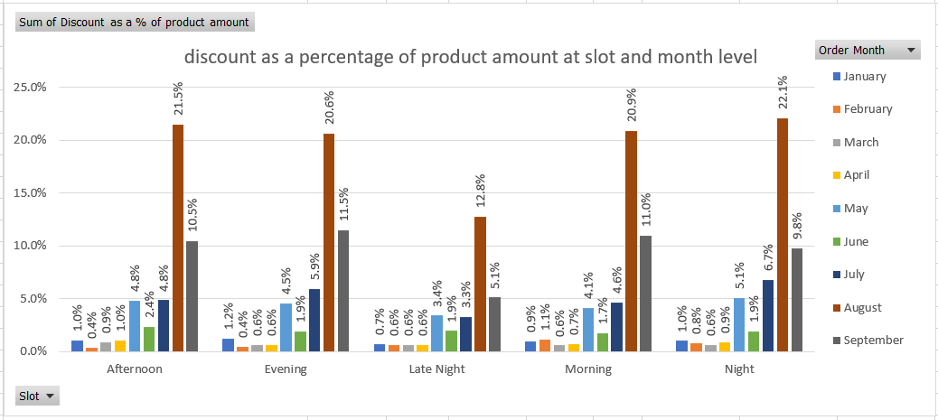
4. Calculate discount as a percentage of product amount at slot and month level.

Slide 8
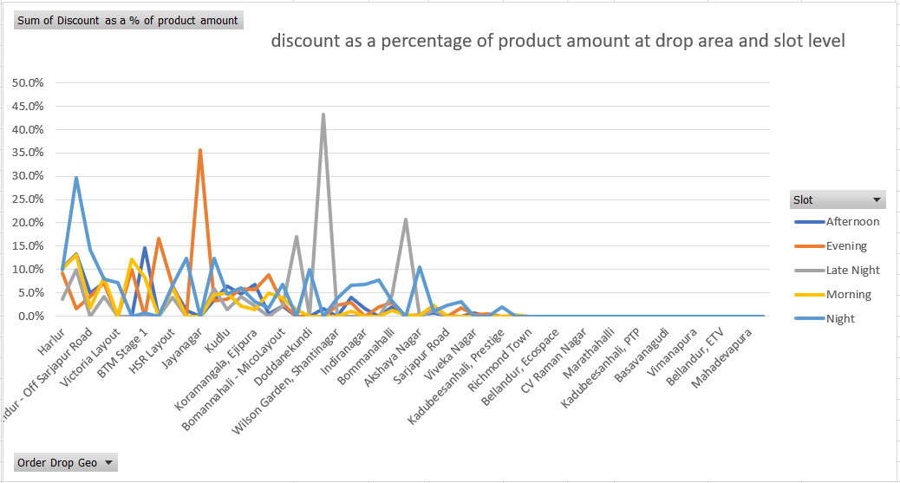
5. Calculate discount as a percentage of product amount at drop area and slot level.

Slide 9
COMPLETION RATE ANALYSIS

Slide 10
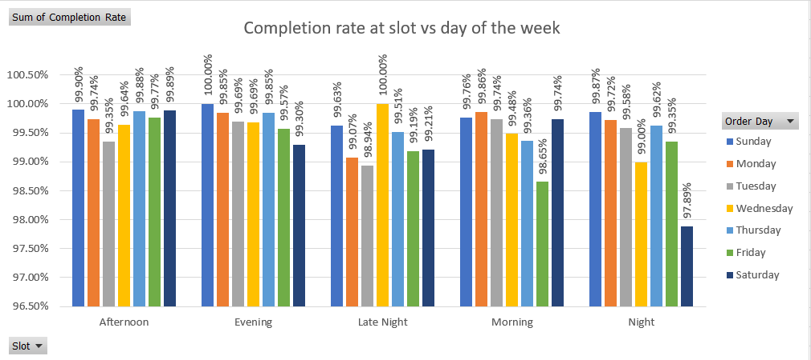
6. Identify Completion rate at slot vs day of the week (Sunday to Saturday) level. Can you spot some pattern in the data?

Slide 11
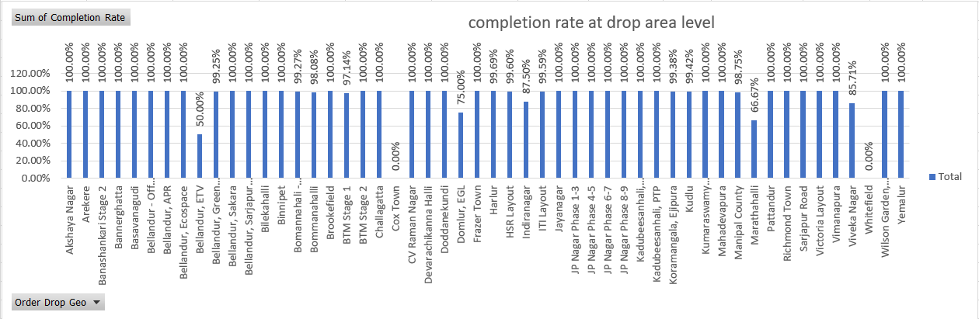
7. Calculate completion rate at drop area level.

Slide 12
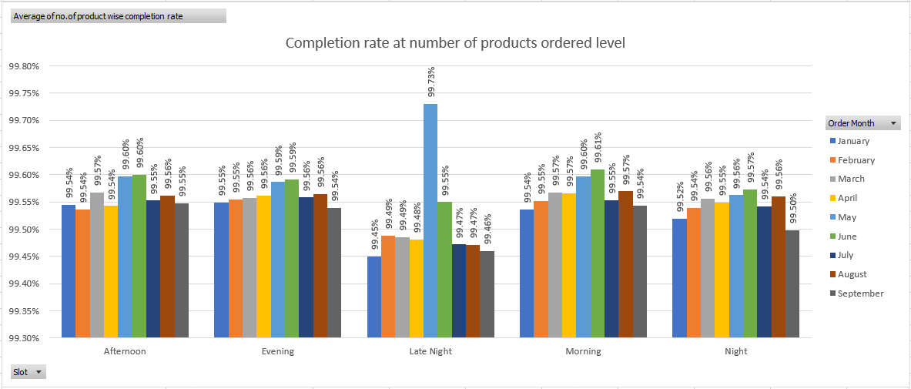
8. Completion rate at number of products ordered level. For this first you need to create a column having number of product against every order.

Slide 13
9. Give you analysis on the any pattern you observe in the completion rate.

Slide 14
CUSTOMER LEVEL ANALYSIS

Slide 15
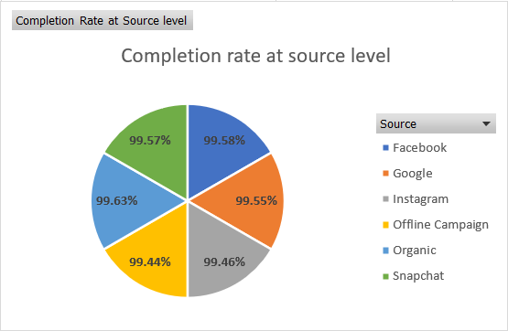
10. Identify Completion rate at source level.

Slide 16
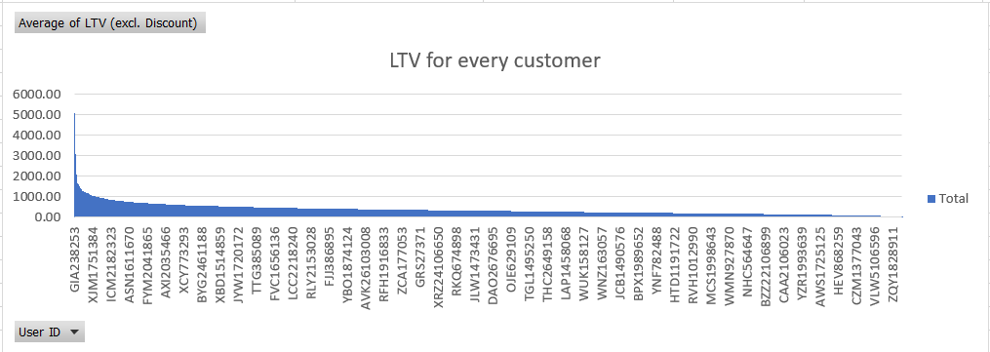
11. Calculate LTV for every customer.

Slide 17
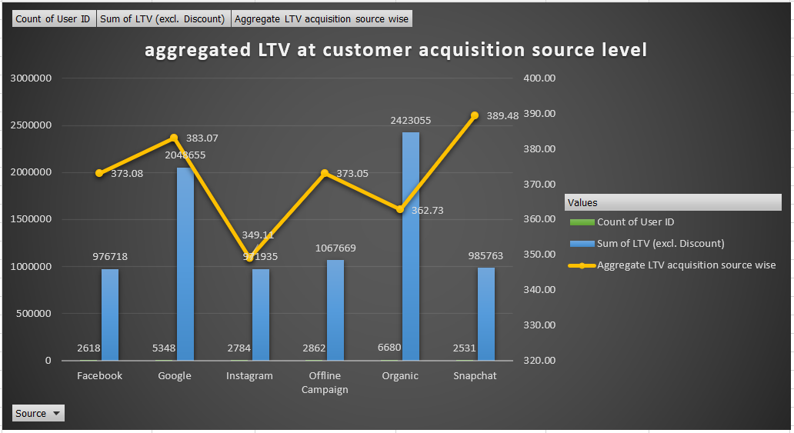
12. Calculate aggregated LTV at customer acquisition source level. Refer to aggregated LTV example.

Slide 18
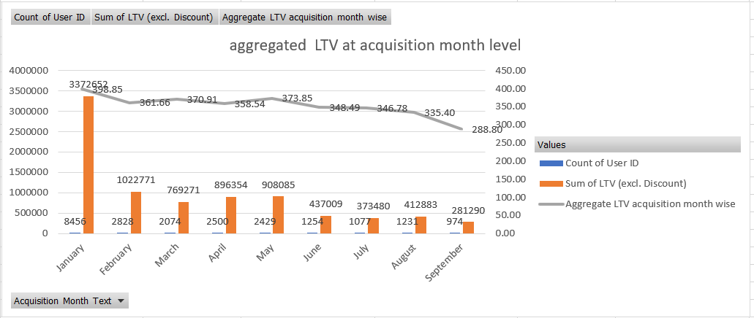
13. Calculate aggregated LTV at acquisition month level. Refer to aggregated LTV example.

Slide 19
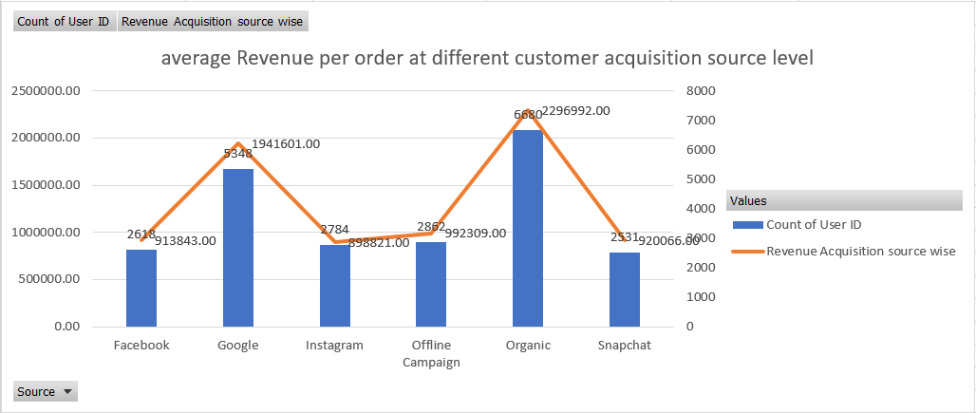
14. What is the average Revenue(Product amount after discount) per order at different customer acquisition source level?

Slide 20
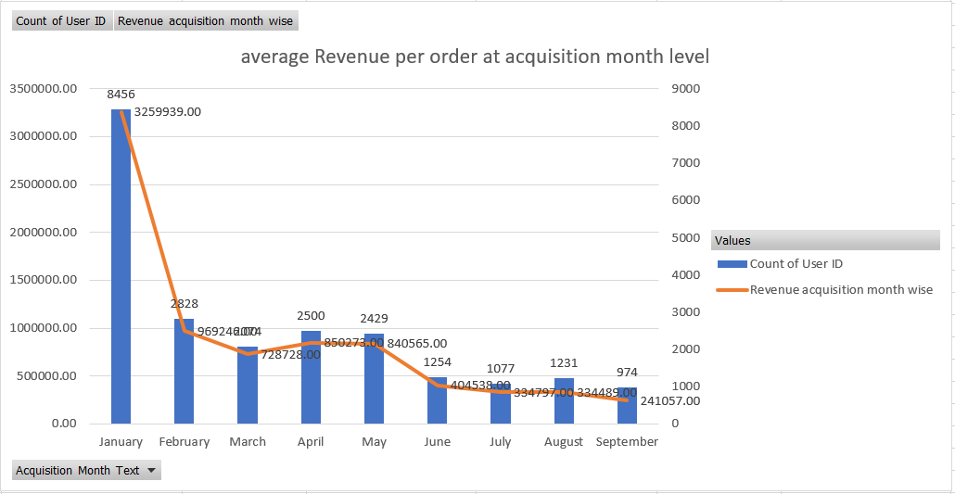
15. What is the average Revenue(Product amount after discount) per order at acquisition month level?

Slide 21
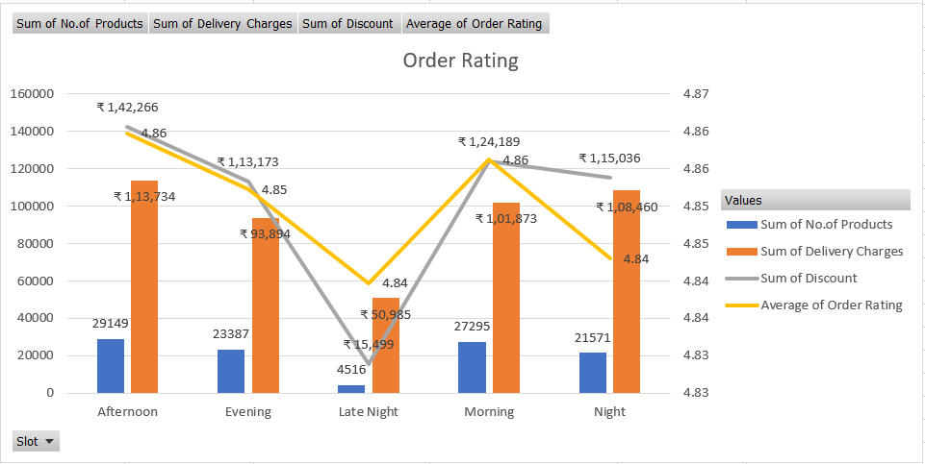
16. Is there any pattern in order rating across slots, number of items placed, delivery charges, discount.

Slide 22
DELIVERY LEVEL ANALYSIS

Slide 23
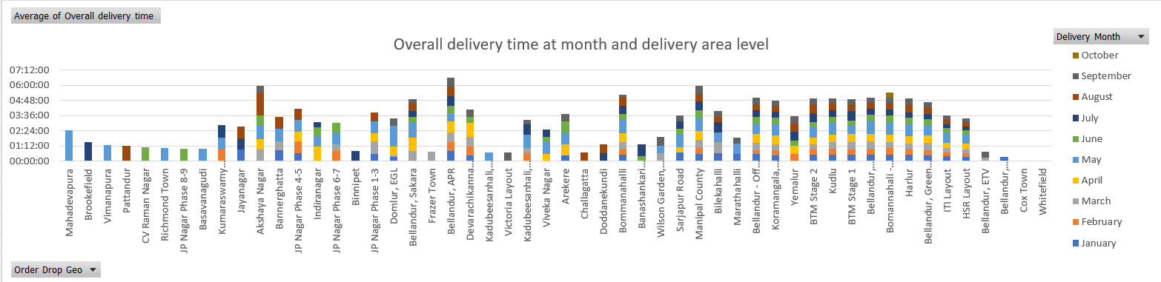
17. Calculate average overall delivery time at month and delivery area level.

Slide 24
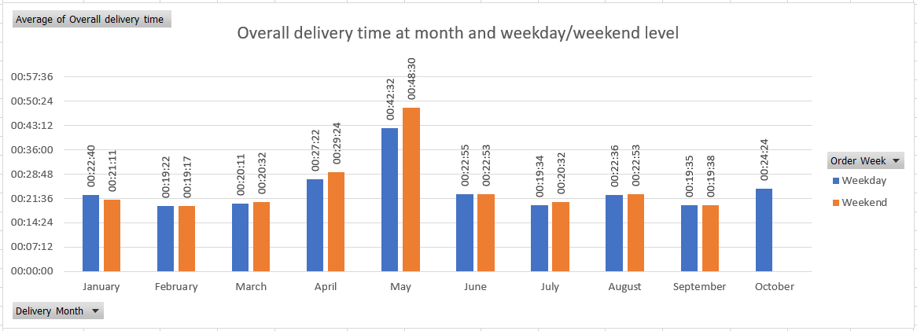
18. Calculate average overall delivery time at month and weekday/weekend level.

Slide 25
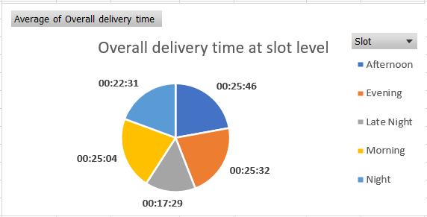
19. Calculate average overall delivery time at slot level. Refer to the definition of slot.

Slide 26
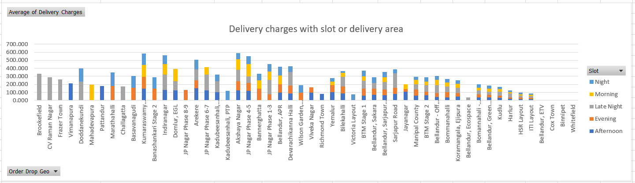
20. Do you see any pattern in delivery charges with slot or delivery area.

Slide 27
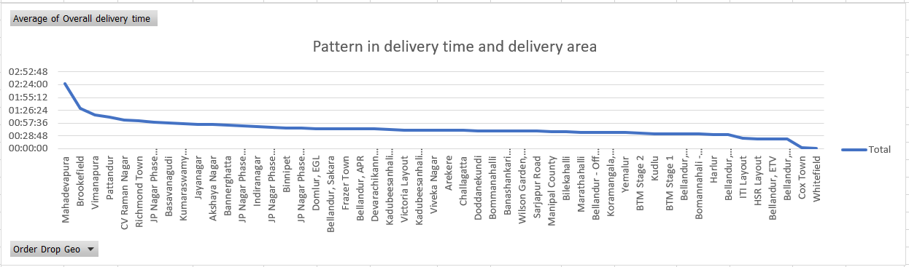
21. Do you see any pattern in delivery time and delivery area. If yes then find out logical reason.

Slide 28
Thank you

